Slide 1
Prove that:
The sum of the degrees of the vertices of any finite graph is even.
Every simple finite graph has two vertices of the same degree.
Prove that “a complete graph with n vertices contains n(n-1)/2 edges.”
If the distance d(u,v) between two vertices u and v that can be connected by a path in a graph is defined to be the length of the shortest path connecting them, then prove that the distance function satisfies the triangle inequality: d(u,v)+ d(v,w) > d(u,w).
Prove that “if u is a vertex of odd degree in a graph, then there exists a path from u to another vertex v of the graph where v also has odd degree.”
Every closed trail (of length n > 2) containing a given vertex (resp. edge) has a subsequence which is a cycle containing that vertex (resp. edge)

Slide 2
Prove that “the sum of the degrees of the vertices of any finite graph is even.”
Each edge ends at two vertices. If we begin with just the vertices and no edges, every vertex has degree zero, so the sum of those degrees is zero, an even number.
Now add edges one at a time, each of which connects one vertex to another, or connects a vertex to itself (if you allow that).
Either the degree of two vertices is increased by one (for a total of two) or one vertex's degree is increased by two.
In either case, the sum of the degrees is increased by two, so the sum remains even.
-------

Slide 3
Prove that “Every simple finite graph has two vertices of the same degree.”
Assume that the graph has n vertices. Each of those vertices is connected to either 0, 1, 2, . . . n-1 other vertices.
If any of the vertices is connected to n-1 vertices, then it is connected to all the others, so there cannot be a vertex connected to 0 others. Thus it is impossible to have a graph with n vertices where one is vertex has degree 0 and another has degree n-1.
Thus the vertices can have at most n-1 different degrees.
But since there are n vertices, at least two must have the same degree.
--------------------

Slide 4


Slide 5

If you simply connect the paths from u to v the to the path connecting v to w you will have a valid path of length d(u,v) + d(v,w). Since we are looking for the path of minimal length, if there is a shorter path it will be shorter than this one, so the triangle inequality will be satisfied.

Slide 6
Prove that if u is a vertex of odd degree in a graph, then there exists a path from u to another vertex v of the graph where v also has odd degree.
Assignment

Slide 7
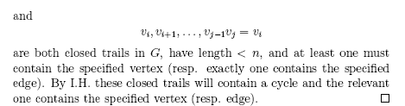
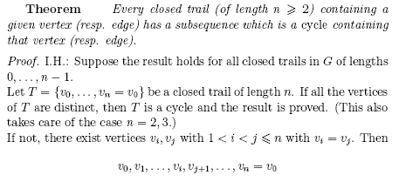

Slide 8
A connected component is a maximal connected subgraph of G. Each vertex belongs to exactly one connected component, as does each edge.
A directed graph is called weakly connected if replacing all of its directed edges with undirected edges produces a connected (undirected) graph. It is connected if it contains a directed path from u to v or a directed path from v to u for every pair of vertices u,v. It is strongly connected or strong if it contains a directed path from u to v and a directed path from v to u for every pair of vertices u,v. The strong components are the maximal strongly connected subgraphs.

Slide 9
A connected component is a maximal subgraph in which all nodes are reachable from every other. Maximal means that it is the largest possible subgraph: you could not find another node anywhere in the graph such that it could be added to the subgraph and all the nodes in the subgraph would still be connected.

Slide 10
Every graph with n vertices and k edges has at least n-k components
Proof
N vertex graph with no edge: n components
Each edge added reduces this by at most 1
So when k edges added number of components is still at least n-k.

Slide 11
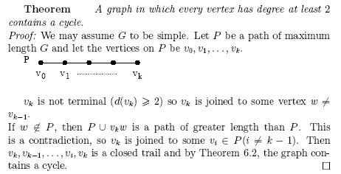

Slide 12
Prove that a finite graph is bipartite if and only if it contains no cycles of odd length.
To show that a graph is bipartite, we need to show that we can divide its vertices into two subsets A and B such that every edge in the graph connects a vertex in set A to a vertex in set B.
Choose any vertex from the graph and put it in set A. Follow every edge from that vertex and put all vertices at the other end in set B. Erase all the vertices you used.
Now for every vertex in B, follow all edges from each and put the vertices on the other end in A, erasing all the vertices you used.

Slide 13
Alternate back and forth in this manner until you cannot proceed. This process cannot encounter a vertex that is already in one set that needs to be moved to the other, since if it did, that would represent an odd number of steps from it to itself, so there would be a cycle of odd length.
If the graph is not connected, there may still be vertices that have not been assigned. Repeat the process in the previous paragraph until all vertices are assigned either to set A or to set B.

Slide 14
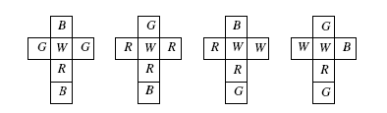
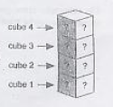
Cube Puzzle

Slide 15
Figure shows four unwrapped cubes that form the instant insanity puzzle. The letters R,W,B and G stand for the colors red, white, blue and green. The object of the puzzle is to stack the blocks in a pile of 4 in such a way that each of the colors appears exactly once on each of the four sides of the stack.

Slide 16
Any cube can have any pair of opposite faces appear on opposite sides of the stack of four. By turning the cube upside-down, the clockwise-counterclockwise orientation of those faces can be flipped, if necessary.
For each cube, we'll draw a graph connecting the pairs of colors on opposite faces, so each cube's graph will consist of four vertices, corresponding to the four possible colors, and three edges that correspond to the pairs of colors that are opposite each other on each different cube.

Slide 17
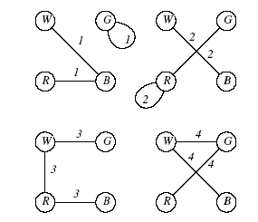

Slide 18
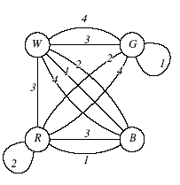
Combining all cubes

Slide 19
Solution of puzzle is obtain 2 subgraph.
Each subgraph contains exactly one edge from each cube.
Subgraphs have no edge in common.
Each subgraph is regular of degree 2.

Slide 20
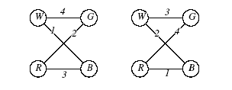

Slide 21

Solve yourself

Slide 22
Tree

Slide 23
Definitions
A graph with no cycle is acyclic.
A forest is an acyclic graph.
A tree is a connected acyclic graph.
A leaf (or pendant vertex) is a vertex of degree 1.
A spanning subgraph of G is a subgraph with vertex set V(G).
A spanning tree is a spanning subgraph that is a tree.

Slide 24
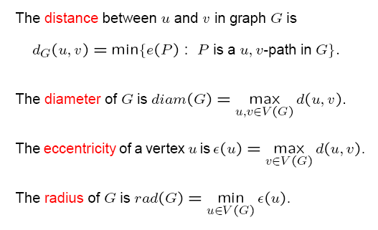
Distance and center in a tree

Slide 25
A tree is a connected forest and every component of a forest is a tree.
Paths are trees.
A tree is a path if and only if its maximum degree is 2.
A star is a tree consisting of one vertex adjacent to all the others.
A graph that is a tree has exactly one spanning tree; the full graph itself.

Slide 26
Properties of Tree (Thm 1-5)
Thm 1: There is one and only one path between every pair of vertices in a tree, T.
Proof: Since tree is a connected graph, there must exist at least one path between every pair of vertices in T. now suppose that between two vertices a and b of T there are two distinct paths. The union of these two paths will contain a circuit and T cannot be a tree.

Slide 27
Thm 2: If in a graph G there is one and only one path between every pair of vertices, G is a tree.
Proof: Existence of a path between every pair of vertices assures that G is connected. A circuit in a graph (with two or more vertices) implies that there is at least one pair of vertices a, b such that there are two distinct paths between a and b. since G has one and only one path between every pair of vertices, G can have no circuit. Therefore, G is a tree.

Slide 28
Thm 3: A tree with n vertices has n-1 edges.
Proof: we know, Every graph with n vertices and k edges has at least n-k components.
In a tree there is only one component.
i.e., n-k = 1
So k= n-1
Now prove it by induction……..

Slide 29
Thm 4: Any connected graph with n vertices and n-1 edges is a tree.
Proof:

Slide 30
Thm 5: A graph is a tree if and only if it is minimally connected.
Proof: a connected graph is said to be minimally connected if removal of any edge from it, disconnects the graph.
A minimally connected graph can’t have a circuit; otherwise, we could remove one edge that is in circuit and still leave graph connected.
Conversely, if a connected graph G is not minimally connected, there must exist an edge e in G such that G-e is connected. Therefore, e is in some circuit, which implies that G is not a tree.
Hence the theorem.

Slide 31
For a graph G with n vertices, the following are equivalent:
G is a tree
G is connected and is circuitless
G is connected and has n-1 edges
G is circuit less and has n-1 edges
There is exactly one path between every pair of vertices in G
G is minimally connected graph

Slide 32
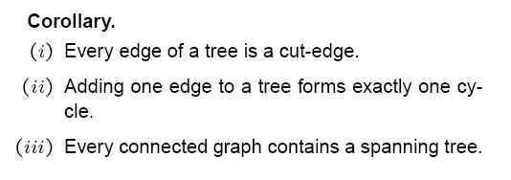
Prove at class room

Slide 33
